Slide 1
Chapter 2
The Individual Entrepreneurial Mind-Set and Personality

Slide 2

The Entrepreneurial Mindset
Entrepreneurial Mindset
  Describes the most common characteristics associated with successful entrepreneurs as well as the elements associated with the “dark side” of entrepreneurship.
Who Are Entrepreneurs?
  Independent individuals, intensely committed and determined to persevere, who work very hard.
  They are confident optimists who strive for integrity.
  They burn with the competitive desire to excel and use failure as a learning tool.
© 2012 Cengage Learning. All rights reserved.

Slide 3



Sources of Research on Entrepreneurs
Research and Popular Publications
Direct
Observation
Speeches, Seminars and Presentations
The Entrepreneurial Mindset
© 2012 Cengage Learning. All rights reserved.

Slide 4
Sources of Research on Entrepreneurs (cont’d)
Publications
  Technical and professional journals
  Textbooks on entrepreneurship
  Books about entrepreneurship
  Biographies or autobiographies of entrepreneurs
  Compendiums about entrepreneurs
  News periodicals
  Venture periodicals
  Newsletters
  Proceedings of conferences
  The Internet
Direct Observation of Practicing Entrepreneurs
  Interviews
  Surveys
  Case studies
Speeches, Seminars, and Presentations by Practicing Entrepreneurs
© 2012 Cengage Learning. All rights reserved.

Slide 5
Common Characteristics of Entrepreneurs
Commitment, determination, and perseverance
Drive to achieve
Opportunity orientation
Initiative and responsibility
Persistent problem solving
Seeking feedback
Internal locus of control
Tolerance for ambiguity
Calculated risk taking
Tolerance for failure
High energy level
Creativity and Innovativeness
Vision
Self-confidence and optimism
Independence
Team building
© 2012 Cengage Learning. All rights reserved.

Slide 6


Outline of the Entrepreneurial Organization
Imagination
Flexibility
Acceptance of Risks
© 2012 Cengage Learning. All rights reserved.
Notes:
8

Slide 7
^{Table} 2.1 Characteristics Often Attributed to Entrepreneurs
Confidence
Perseverance, determination
Energy, diligence
Resourcefulness
Ability to take calculated risks
Dynamism, leadership
Optimism
Need to achieve
Versatility; knowledge of product, market, machinery, technology
Creativity
Ability to influence others
Ability to get along well with people
Initiative
Flexibility
Intelligence
Orientation to clear goals
Positive response to challenges
Independence
Responsiveness to suggestions and criticism
Time competence, efficiency
Ability to make decisions quickly
Responsibility
Foresight
Accuracy, thoroughness
Cooperativeness
Profit orientation
Ability to learn from mistakes
Sense of power
Pleasant personality
Egotism
Courage
Imagination
Perceptiveness
Toleration of ambiguity
Aggressiveness
Capacity for enjoyment
Efficacy
Commitment
Ability to trust workers
Sensitivity to others
Honesty, integrity
Maturity, balance
Source: John A. Hornaday, “Research about Living Entrepreneurs,” in Encyclopedia of Entrepreneurship, ed. Calvin Kent, Donald Sexton, and Karl Vesper, © 1982, 26–27. Adapted by permission of Prentice-Hall, Englewood Cliffs, NJ.
© 2012 Cengage Learning. All rights reserved.

Slide 8
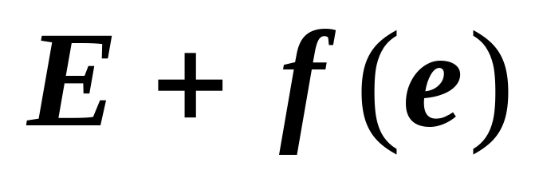
Entrepreneurship Theory
Entrepreneurs cause entrepreneurship.
  Entrepreneurship is a function of the entrepreneur:
  Entrepreneurship is the interaction of skills related to inner control, planning and goal setting, risk taking, innovation, reality perception, use of feedback, decision making, human relations, and independence.
© 2012 Cengage Learning. All rights reserved.

Slide 9
The Entrepreneurial Journey
Entrepreneurs
  Create ventures much as an artist creates a painting.
  Are formed by the lived experience of venture creation.
Experiential Nature of Creating a Sustainable Enterprise
  Emergence of the opportunity
  Emergence of the venture
  End emergence of the entrepreneur
© 2012 Cengage Learning. All rights reserved.

Slide 10
The Dark Side of Entrepreneurship
The Entrepreneur’s Confrontation with Risk
  Financial risk versus profit (return) motive varies in entrepreneurs’ desire for wealth.
  Career risk—loss of employment security
  Family and social risk—competing commitments of work and family
  Psychic risk—psychological impact of failure on the well-being of entrepreneurs
© 2012 Cengage Learning. All rights reserved.

Slide 11
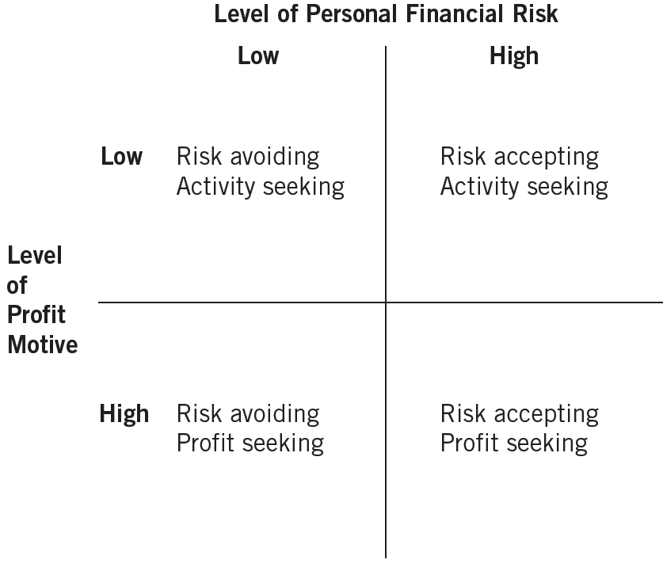
^{Figure} 2.1 Typology of Entrepreneurial Styles
Source: Thomas Monroy and Robert Folger, “A Typology of Entrepreneurial Styles: Beyond Economic Rationality,” Journal of Private Enterprise IX(2) (1993): 71.
© 2012 Cengage Learning. All rights reserved.

Slide 12
Stress and the Entrepreneur
Entrepreneurial Stress
  The extent to which entrepreneurs’ work demands and expectations exceed their abilities to perform as venture initiators, they are likely to experience stress.
Causes of Entrepreneurial Stress
  Loneliness
  Immersion in business
  People problems
  Need to achieve
© 2012 Cengage Learning. All rights reserved.

Slide 13
Entrepreneurs: Type A Personalities
Chronic and severe sense of time urgency.
Constant involvement in multiple projects subject to deadlines.
Neglect of all aspects of life except work.
A tendency to take on excessive responsibility, combined with the feeling that “Only I am capable of taking care of this matter.”
Explosiveness of speech and a tendency to speak faster than most people.
© 2012 Cengage Learning. All rights reserved.

Slide 14
Dealing with Stress
Networking
Getting away from it all
Communicating with employees
Finding satisfaction outside the company
Delegating
Exercising Rigorously
© 2012 Cengage Learning. All rights reserved.

Slide 15
The Entrepreneurial Ego
Self-Destructive Characteristics
  Overbearing need for control
  Sense of distrust
  Overriding desire for success
  Unrealistic optimism
Entrepreneurial Motivation
  The quest for new-venture creation as well as the willingness to sustain that venture.
    Personal characteristics, personal environment, business environment, personal goal set (expectations), and the existence of a viable business idea.
© 2012 Cengage Learning. All rights reserved.

Slide 16
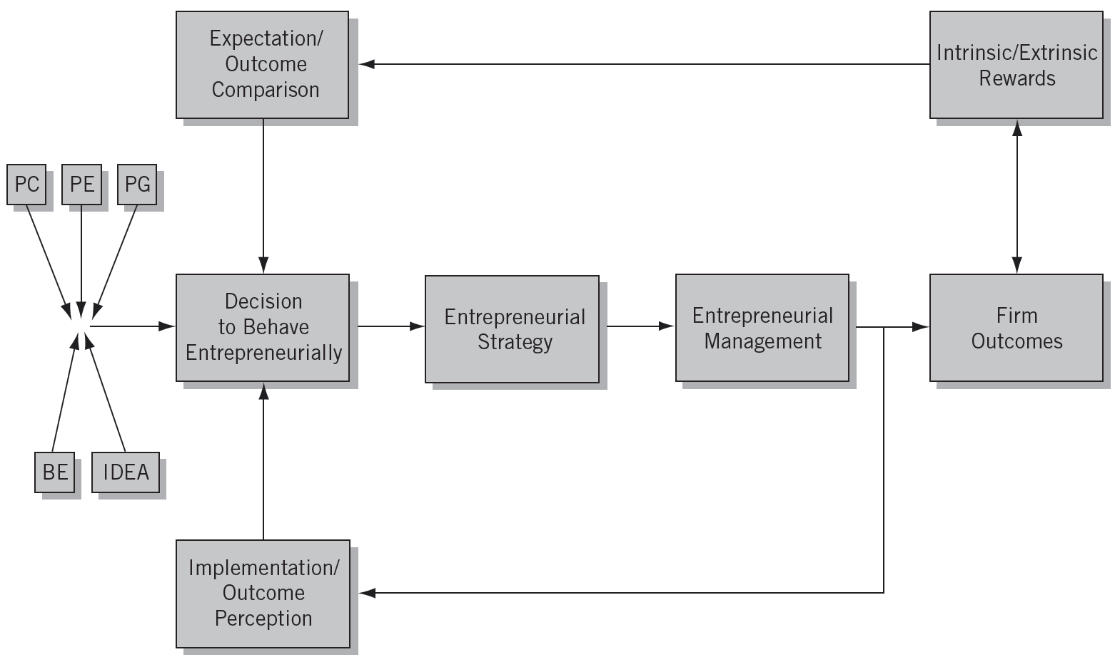
^{Figure} 2.2 A Model of Entrepreneurial Motivation
Source: Douglas W. Naffziger, Jeffrey S. Hornsby, and Donald F. Kuratko, “A Proposed Research Model of Entrepreneurial Motivation,” Entrepreneurship Theory and Practice (spring 1994): 33.
© 2012 Cengage Learning. All rights reserved.

Slide 17
Key Terms and Concepts
calculated risk taking
career risk
dark side of entrepreneurship
delegating
drive to achieve
entrepreneurial behavior
entrepreneurial mind-set
entrepreneurial motivation
external optimism
family and social risk
financial risk
immersion in business
loneliness
need for control
networking
opportunity orientation
psychic risk
risk
stress
tolerance for ambiguity
tolerance for failure
vision
© 2012 Cengage Learning. All rights reserved.

